Slide 1
Computational Design Methods
Your Project Title
Author [= you] | Date [= e.g. 18.10.2018] | Your Matrikel-Number
[please replace the information and delete the brackets!]

Slide 2
Concept
Starting Point | Sources | Task Description
This document is a template! Please change the figures and replace text place holders like this one.
On this first page:
Mention where you start from. E.g. from which website you‘ve taken your starting code.
Describe the aim that you‘ve defined for your exercise.
Alpine Architecture
Taut, B. (1917)

Slide 3
Implementation
Code / GH definition documentation and description
Please document your code and Grasshopper definition as shown on this page! Of cause you can use more than one page.
Look at the last page for an instruction how to format your code so that it looks like the example on the right side here.
We create a grid of rectangles again, but this time we grow the rectangles until they intersect with another one. With the first part of the code we are familiar with. The section where we grow the rectangles starts at line 20. We use some additional lists to manage the growth process. In line 26 a do loop starts, which is executed until all rectangles are grown to a size that they would intersect with another one if they grow another step.
Since there is no direct copy or duplicate function for Rectangle3d, we used a GH_Rectangle. Both are very similar, but the second one is implemented in the Grasshopper namespace. The copied rectangle copyRect is now scaled by the factor 1.2 in line 35.
Afterwards we test if the existing rectangles intersect with the new copyRect. Therefore we use a foreach look in line 40. The conditional check in line 42 ensures that we don’t compare the same rectangles with each other. The intersection computation is done in line 44 and returns an events variable of the type Rhino.Geometry.Intersect.CurveIntersections. We just use it to test if there is an intersection in line 45.
1 private void RunScript(int nr, Rectangle3d rect, ref object A)
2 {
3 int iterations = nr;
4 List<Extrusion> collectBreps = new List<Extrusion>();
5 List<Rectangle3d> collectRectangles = new List<Rectangle3d>();
6
7 // -- first loop used for x coordinates
8 for(int i = 0; i < iterations; i++)
9 {
10 // -- second loop used for y coordinates
11 for(int k = 0; k < iterations; k++)
12 {
13 // -- create the rectangles
14 Rectangle3d myRectangle = CreateRectangles(i, k);
15 collectRectangles.Add(myRectangle);
16 }
17 }
18 // -- add the input rectangle to the list to block growth in a corridor :)
19 if(!rect.Equals(null)) collectRectangles.Add(rect);
20
21 // -- grow rectangles
22 List<Rectangle3d> growCadidates = new List<Rectangle3d>(collectRectangles); // copy our list
23 List<Rectangle3d> toRemoveRects = new List<Rectangle3d>();
24 List<Rectangle3d> grownRectangles = new List<Rectangle3d>();
25 if(!rect.Equals(null)) growCadidates.RemoveAt(growCadidates.Count - 1);
26
27 int counter = 0; // security counter to avoid endless looing!
28 int maxIterations = 20;
…

Slide 4
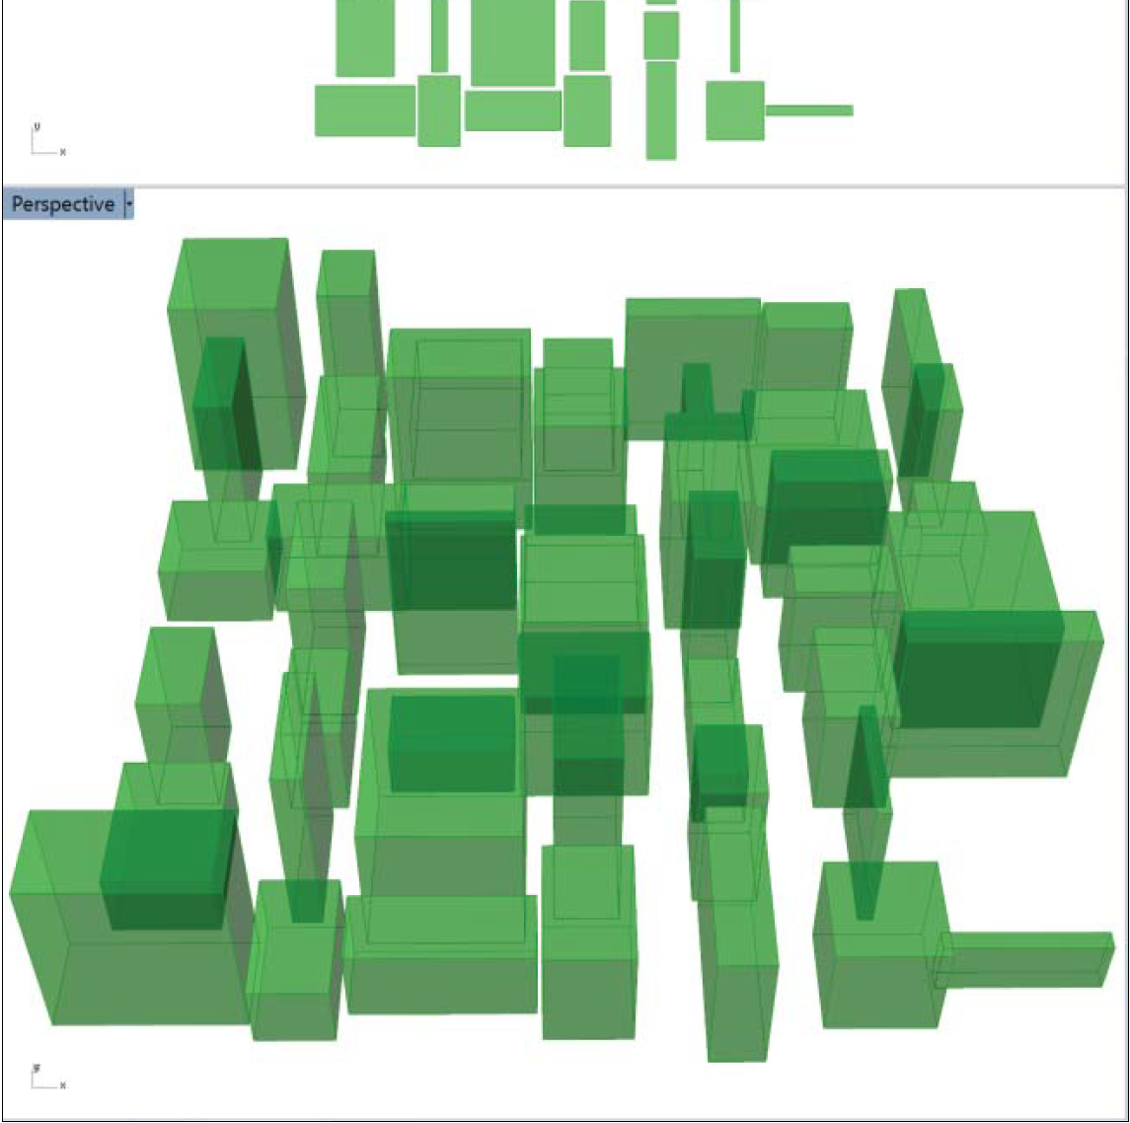
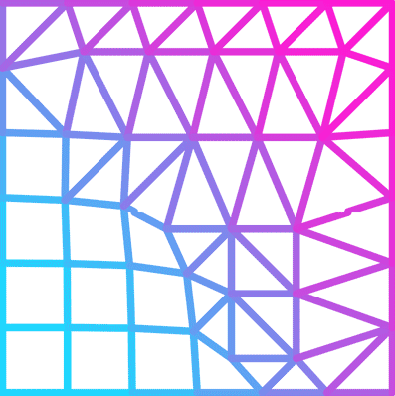
Results
Results and conclusions
Show the results of your program. Include how it is included into Grasshopper context – if it is connected to other components.
Make screenshots or even better animated gifs of the results of your program. Show variants that result from different parameter values and describe them.
Add you conclusion at the end! For example describe advantages and disadvantages for achieving the aim you defined in the beginning compared to manual drawing.
There is a great and very easy to use tool for capturing your screen and turning it into small animated gifs/videos. Its open source and excellently done! http://www.screentogif.com/. You can convert gifs to mp4 video files by some web-converters.
I‘m an animated gif. Run the PowerPoint presentation to see me in action!

Slide 5
Conclusions
Results and conclusions
Add some personal conclusion on your project. Relate it to the concept that you formulated in the beginning, the tools and methods that you used, and the evaluation of your results plus a brief outlook.

Slide 6
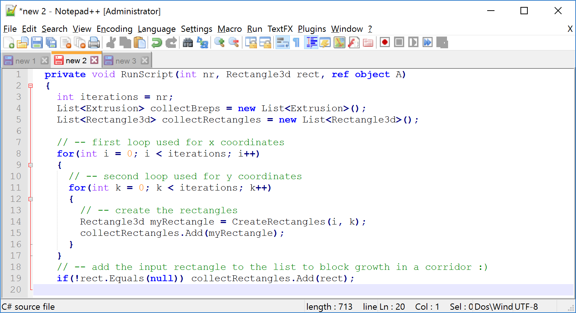
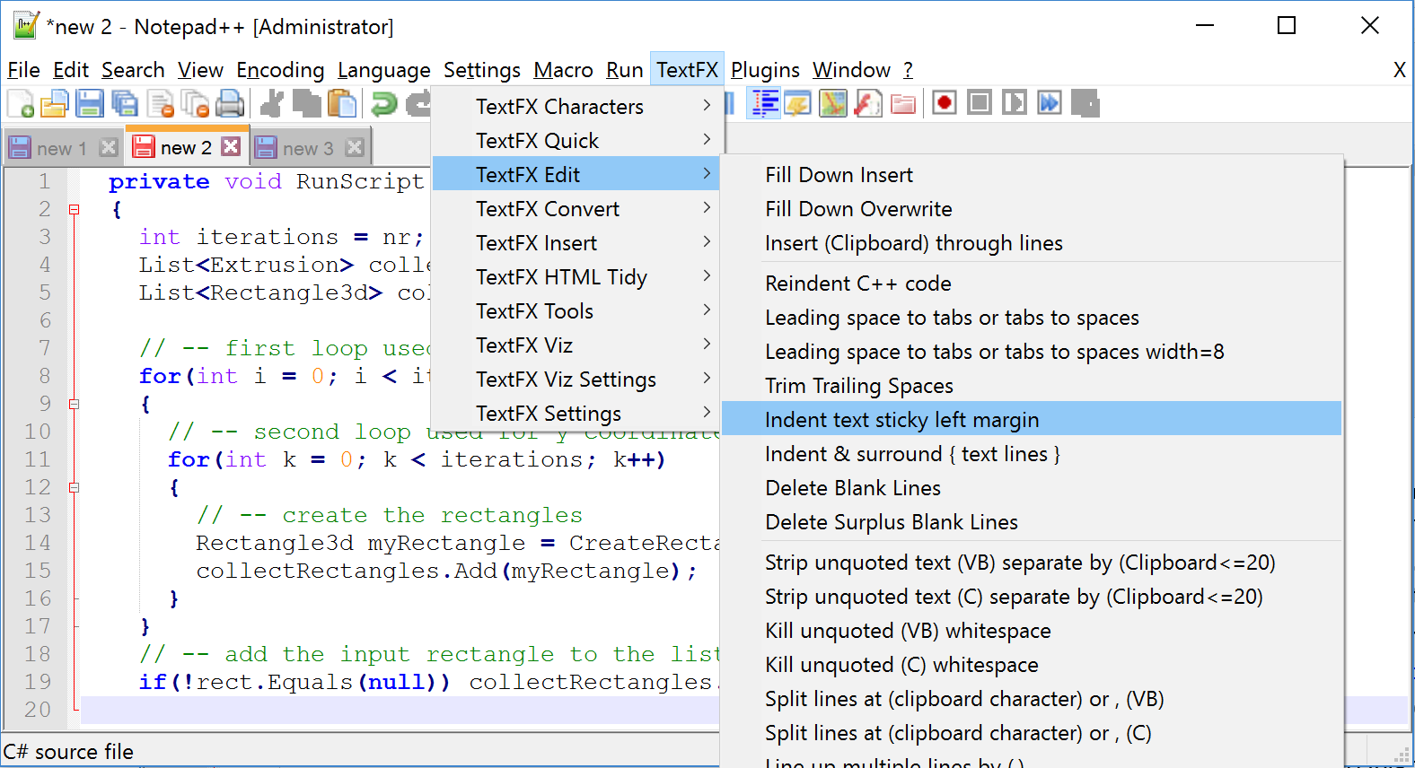
Tutorial how to copy your code into this document with the correct format
To be able to bring your code in the nice format that we have in our Grasshopper C# editor you need to follow theses steps:
Install Notepad++ on your computer: https://notepad-plus-plus.org/download/v6.9.1.html
Start with a new file (File / New) and set the language to C# (Language / C / C#). Next copy the code from your Grasshopper C# component into this file. It should look like this:
Since for code description it’s comfortable to add line numbers. Therefore you need to install a Plugin for Notepad++. Go to Plugins / Plugin Manager, select TextFX and press Install. This adds a new menu entry at the top.
To add line numbers proceed as follows:
Edit / Select All.
TextFX / TextFX Edit / Indent text sticky left margin.
Edit / Column Editor (Alt + C). This opens a dialog window, where you select Number to Insert and add Initial number: 1 and Increase by: 1. Format is Dec. Press OK.

Slide 7
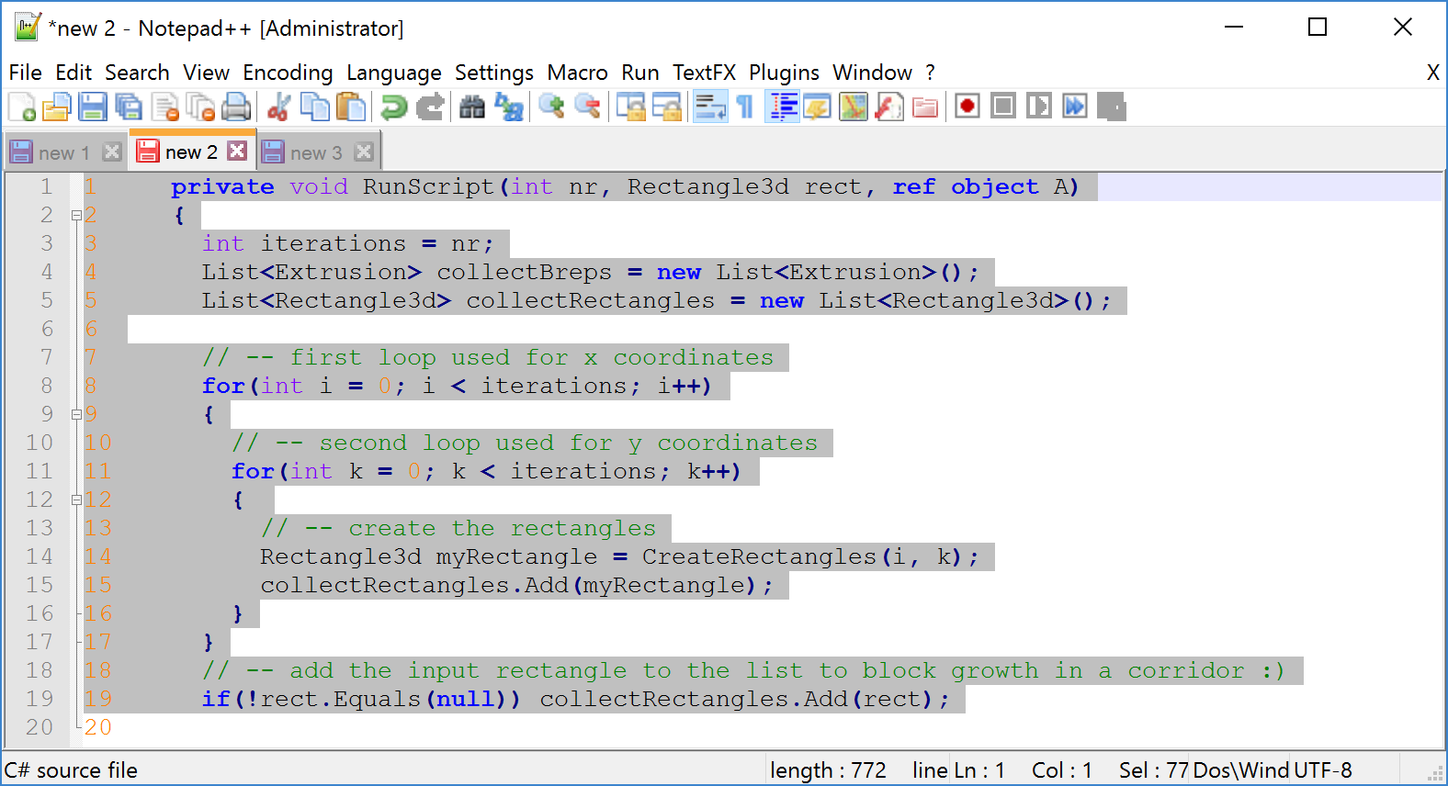
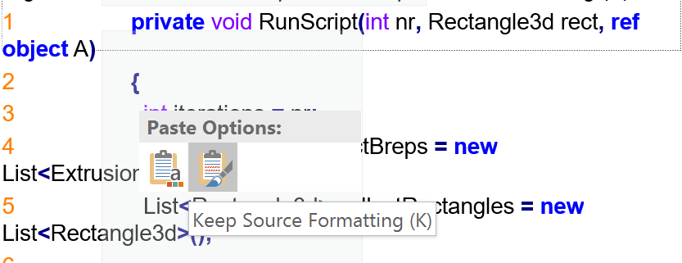
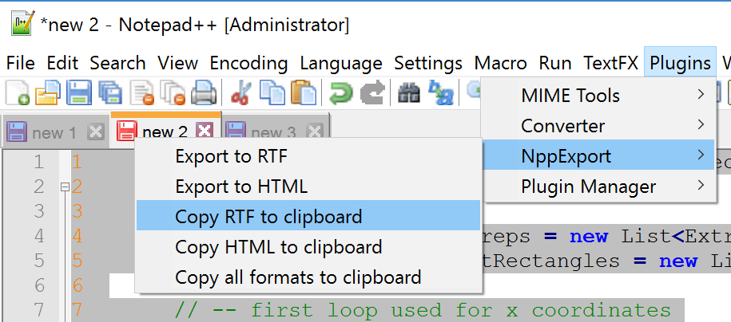
Tutorial how to copy your code into this document with the correct format
Now, you have added a column and filled it with numbers:
This copies the formatted code to your clipboard. Change to PowerPoint and insert it into an empty Text Box like this one in the following way:
Right mouse click / Paste Options / Keep Source Formating (K):
Nearly done. Just mark all and select font size 9 and font type Consolas. Finished!
You need to copy this nice formatting via: Plugins / NppExport / CoyRTF to clipboard:
1 private void RunScript(int nr, Rectangle3d rect, ref object A)
2 {
3 int iterations = nr;
4 List<Extrusion> collectBreps = new List<Extrusion>();
5 List<Rectangle3d> collectRectangles = new List<Rectangle3d>();
6
7 // -- first loop used for x coordinates
8 for(int i = 0; i < iterations; i++)
9 {
…

